Slide 1
Statistics with Spa ows
Measures of precision of an estimate
Julia Schroeder
Julia.schroeder@imperial.ac.uk

Slide 2
Outline
Precision of sampling
Standard error of mean
How to improve statistical precision
Square-root law of sample size
95CI

Slide 3
So what’s the standard error then?
Standard deviation describes the spread and variability of a distribution
Standard errors describe the precision of the mean!
It is really called: Standard error of the sampling distribution

Slide 4
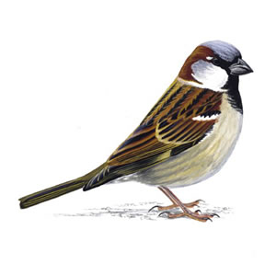
Complete population

Slide 5
Sample population

Slide 6
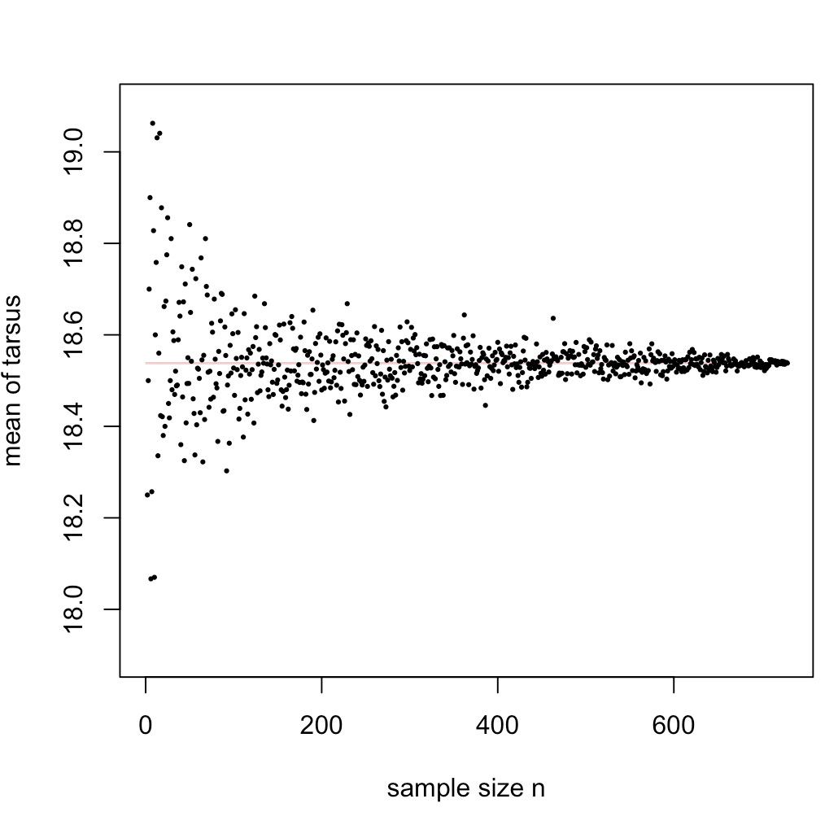

Slide 7
So what’s the standard error then?
It describes:
How precise is the mean we calculate from a sample
in comparison to the REAL mean?

Slide 9

So what’s the standard error then?
It describes:
How precise is the mean we calculate from a sample
in comparison to the REAL mean?
$$SE= \sqrt{\frac{σ^{2}}{n}}$$

Slide 10
So what’s the standard error then?
It describes:
How precise is the mean we calculate from a sample
in comparison to the REAL mean?
$$SE= \sqrt{\frac{σ^{2}}{n}}$$

Slide 11
So what’s the standard error then?
Standard error of the mean
Associated with the variance!
Tied to the mean (or any mean-type estimate)!
$$SE= \sqrt{\frac{σ^{2}}{n}}$$

Slide 12
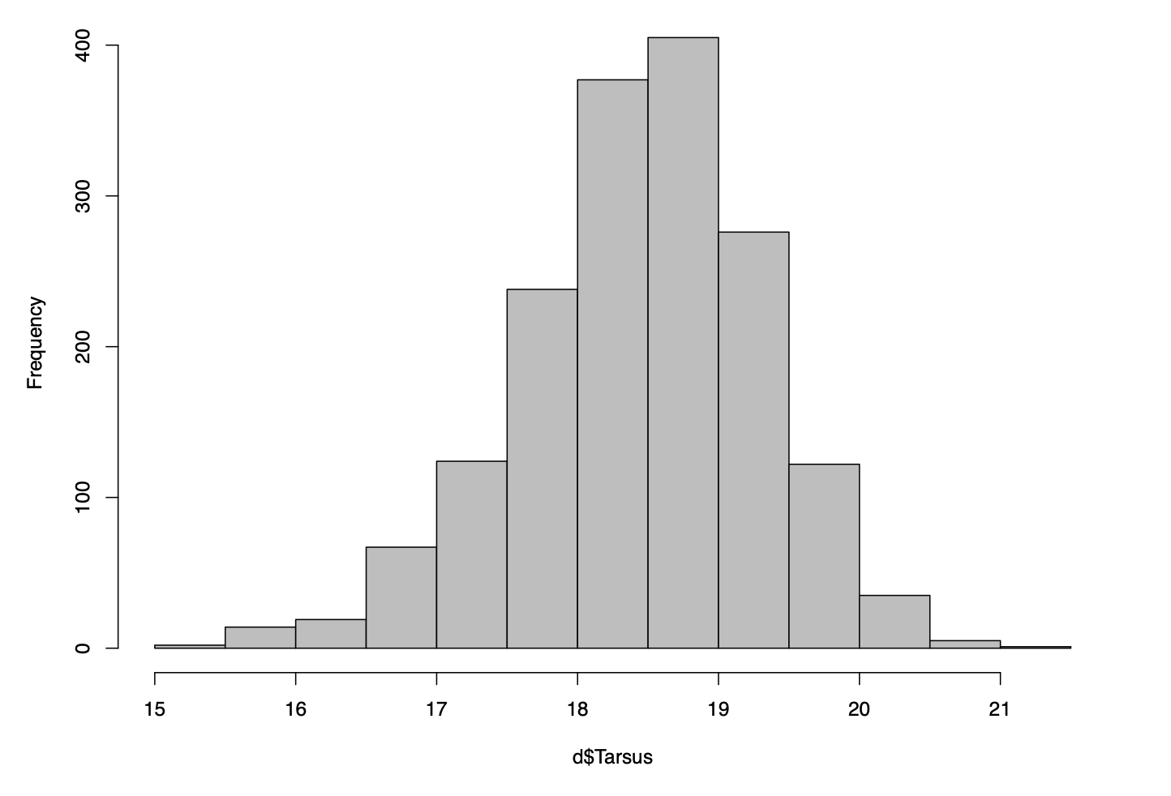
Standard error vs standard deviation
Standard deviation | Standard error
Describes the spread of the distribution | Quantifies the precision of an estimate
The sqrt of the variance
Descriptive of data | Allows us to judge the quality of our statistic
(mean, SD: 12.4, 3) | mean±SE (12.4±2.4)

Slide 13
Standard error vs standard deviation
Standard deviation | Standard error
Describes the spread of the distribution | Quantifies the precision of an estimate
The sqrt of the variance
Descriptive of data | Descriptive of statistic (mean)
(mean, SD: 12.4, 3) | mean±SE (12.4±2.4)

Slide 14
Standard error vs standard deviation
Standard deviation | Standard error
Describes the spread of the distribution | Quantifies the precision of an estimate (mean)
The sqrt of the variance
Descriptive of data | Descriptive of statistic (mean)
 | Quantifies our judgement
(mean, SD: 12.4, 3) | (mean±SE: 12.4±2.4)

Slide 15
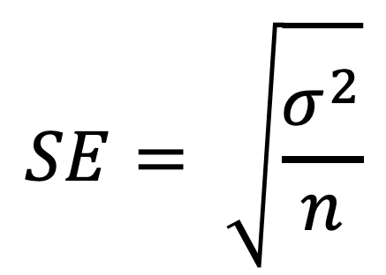
Standard error is dependent on standard deviation and sample size!
$$SE= \sqrt{\frac{σ^{2}}{n}}$$

Slide 16
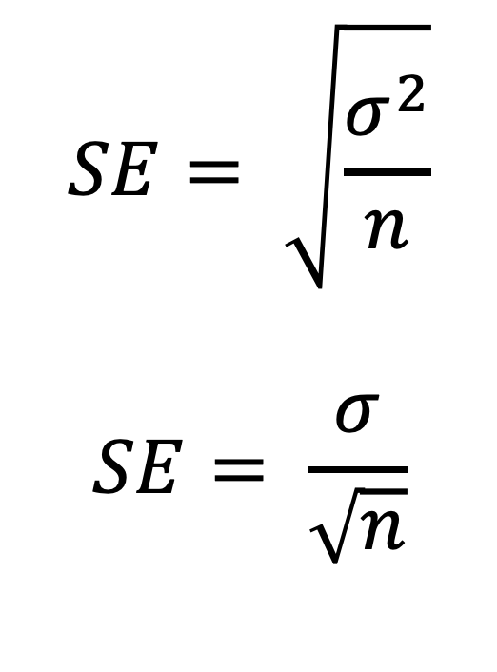
Standard error is dependent on standard deviation and sample size!
$$SE= \sqrt{\frac{σ^{2}}{n}}$$
$$SE= \frac{σ}{\sqrt{n}}$$

Slide 17
Let’s have a look at how that looks in R:

Slide 18
Standard error is dependent on standard deviation and sample size!
$$SE= \sqrt{\frac{σ^{2}}{n}}$$
$$SE= \frac{σ}{\sqrt{n}}$$
How can we double the precision?

Slide 19
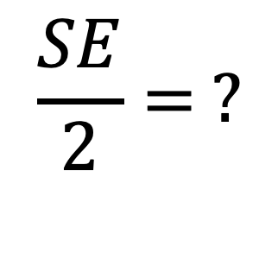
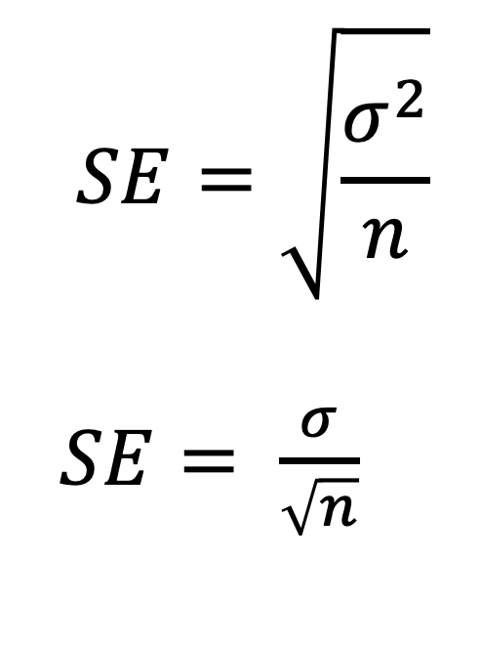
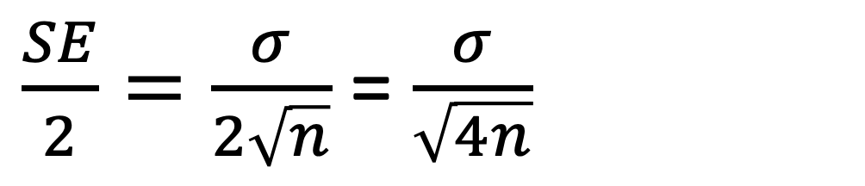
Standard error is dependent on standard deviation and sample size!
$$SE=\sqrt{\frac{σ^{2}}{n}}$$
$SE= \frac{σ}{\sqrt{n}}$
$$\frac{SE}{2}= ?$$
How can we double the precision?
By its squared term!
$\frac{SE}{2}=\frac{σ}{2\sqrt{n}}$ = $\frac{σ}{\sqrt{4n}}$

Slide 20
Another measure of precision: 95CI
The 95% confidence interval

Slide 21
Another measure of precision: 95CI
The 95% confidence interval
Encompasses the population “true” value

Slide 22
Another measure of precision: 95CI
The 95% confidence interval
Encompasses the population true mean

Slide 23

Another measure of precision: 95CI
The 95% confidence interval
Encompasses the population true mean
$$95CI=±1.96 se$$

Slide 24
Another measure of precision: 95CI
The 95% confidence interval
Encompasses the population true mean Guesstimate: 2 SE
$$95CI=±1.96 se$$

Slide 25
Centrality and spread:
Most popular:
mean
Measure of precision:
SE
Mean±SE
Two similarly meaningful measures:
Variance
Standard deviation
Measure of precision:
? none

Slide 26
SE =! SD
SE
Measure of precision of mean
Secondary statistic
(primary is mean)
Mean, variance
Mean±SE, variance
SD
Measure of spread of data
Primary statistic
Mean, SD
Mean±SE, SD
Mean±SD WRONG

Slide 27
Descriptive statistics
a measure of mean, plus uncertainty (SE, 95CI)
a measure of spread (variance or SD)
sample size
Missing values
Data structure

Slide 28
Exercise. (no hand out – flying solo!):
Exercise:
How can we calculate SE in R? Is there a package?
Calculate SE of Tarsus
Then, calculate SE for Tarsus of a subset the dataset – only 2001 data
Do the same for the variables Wing length, Bill length, Body mass
Have a think: can we calculate the SE of variance? Discuss on module board

Slide 29
Learning aims:
How to calculate SE
SE is a measure of precision
SE is dependent on sample size
To improve precision, we have to improve sample size by the square value!
95CI
Know the difference between SD and SE
Know the difference between describing data and describing statistics

